Slide 1
Installation and Initial Setup
You can download OpenMRS from the OpenMRS web site.
http://openmrs.org/download/
Requirements: Java 6 or higher installed on your system to run OpenMRS.
There are two ways to install OpenMRS: Standalone, and Enterprise.
OpenMRS Standalone provides a simplified installation option with an embedded database and web server.
OpenMRS Standalone should run fine for smaller installations (fewer than 10,000 patient records), but if you are setting up a larger installation, it is recommend to use the Enterprise installation.
If you are not sure which makes sense, you can start with a standalone installation and migrate your data to the enterprise version later.
OpenMRS Enterprise is appropriate for larger installations. If you already have a Java servlet container and a database installed, and you want to set up OpenMRS to use these resources, you should also use OpenMRS Enterprise.

Slide 2
OpenMRS Standalone
To install the standalone version, download the ZIP file and decompress it, then double-click the openmrs-standalone.jar file to run it.
The first time you run this file, it will install OpenMRS and open your browser to the new OpenMRS instance.
Do not delete or rename any files or folders after decompressing the ZIP file. These files and folders are required by the standalone installer.
Alternatively, from the command line, you can navigate to the decompressed folder and run the following command:
java -jar standalone-1.1.jar

Slide 3
Upgrading Standalone
To upgrade a copy of OpenMRS Standalone, do the following:
Stop the previous version of OpenMRS Standalone and exit the application.
Download and extract the most recent version of OpenMRS Standalone.
Copy your database directory from the previous version to this new OpenMRS directory.
Copy your openmrs-standalone-runtime.properties from the previous version to this new OpenMRS directory.
Install OpenMRS Standalone as described above. The new version of OpenMRS will run with your old data.

Slide 4
Logging in to the system
OpenMRS runs as a web application, meaning you use it via a web browser. Before you can access any pages in the system, you need to log in. To do this the first time, you will need to know the administrator password that you chose during first-time setup.
By default, the initial username and password are as follows:
Username: admin
Password: Admin123
You must immediately change the admin password after installation for security purposes. To change your password, click My Profile in the upper right of OpenMRS, and choose the Change Login Info tab. Update your password, then click Save Options.
You can also change your username, and provide your real name.

Slide 5
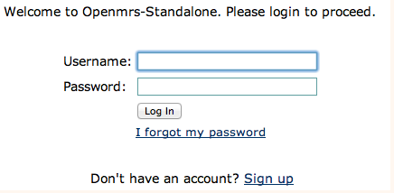
Logging in to the system (Continued)
The OpenMRS login screen.
Users that forget their password may reset it if they have configured a secrete question, and know the answer.

Slide 6
Stopping and Restarting
As long as OpenMRS is running, you can return to the application by opening the following URL in your browser.
http://localhost:8081/openmrs-standalone/
Before you change certain preferences, such as the port on which MySQL or Tomcat runs, you must stop the application.
To stop the application, use the Stop button in the user interface, or choose File > Quit. Alternatively, run the JAR file on the command line with a -stop parameter.
You can restart the GUI by clicking Start, or double-clicking on the JAR file again. Alternatively, you can run the JAR file with a -start parameter.
By default, OpenMRS runs the MySQL database on port 3316, and the Tomcat server on port 8081. To use a different port, stop the application, then change the port number in the openmrs-standalone-runtime.properties file or in the GUI, and restart. To override the port from the command line, run the JAR file with a -tomcatport or -mysqlport parameter.
Changing the port number will change the URL used to access the application. To access the application, you can choose File > Launch Browser, or run the JAR file with a -browser parameter.

Slide 7
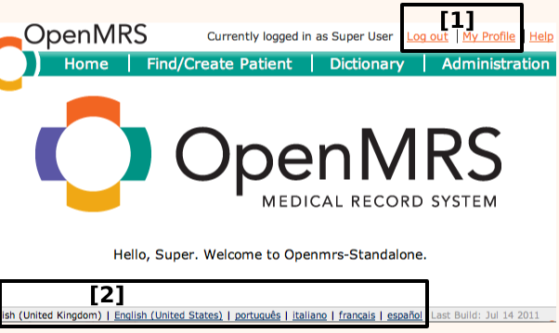
Home
In the default installation of OpenMRS, all users see the same home page after logging in. To customize different home pages for different types of users, you can use the Role Based Homepage module.
As shown in the OpenMRS home page above, all pages allow you to:
Log out and edit your profile, or
Change your language for the current session.
You can configure the allowed languages via a global property in the Administration page.

Slide 8
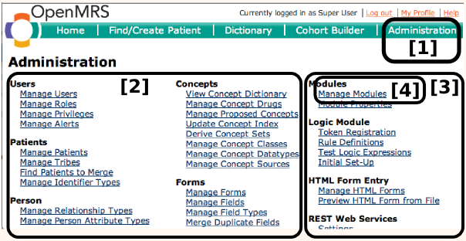
Administration
As a system administrator or manager for an OpenMRS installation, you will frequently need to access the configuration and administration functions accessible through the Administration page.
You can access the Administration page from anywhere in the application by clicking its link in the top-right of the screen.
Configuration pages for the OpenMRS core functionality are listed in the left and center columns.
Configuration pages for functionality in add-on modules are listed in the right column.
You add/remove/start/stop add-on modules from the Manage Modules page.

Slide 9
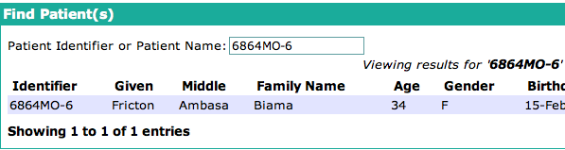
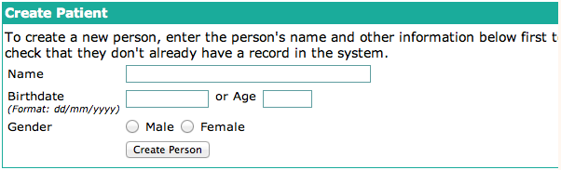
Viewing and creating patients
One of the most common actions for non-administrative users of the system is to find and open existing patient records. If the desired patient record is not found, users may be able to create new ones if they have sufficient privileges.
You can search for a patient by ID number. Clicking on the search result will open that patient's dashboard. If a user does not find a patient by ID number or name, you may create a new patient.

Slide 10
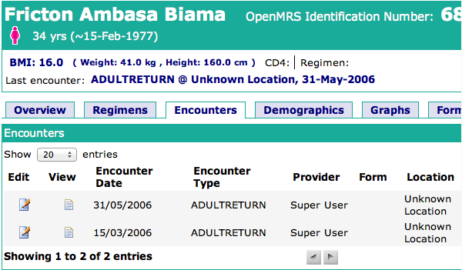
Patient dashboard
Data entry staff will spend a lot of time on the patient dashboard page. This gives access to different parts of a patient's record and allows you to enter forms into the record.
The workflow of the patient dashboard page is not efficient for a clinician who wants to access a patient's record at the point of care. To support those workflows you should consider downloading and installing the optional the Clinical Summary module or the HTML Form Flowsheet module.

Slide 11
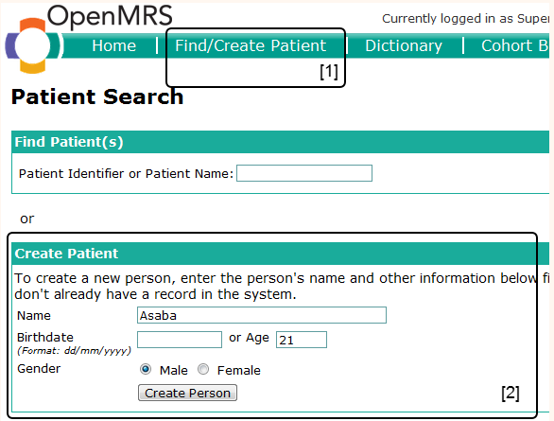
Registering Patients
In order to be able to fill out forms for a patient, you must first create a Patient. Often, a registration clerk or data entry clerk will create patients in the system. You should decide which model works best for your clinic, to prevent duplication of records.
You can create patients by clicking Find/Create Patient in the top menu.
The first step in creating a Patient is to fill out the short Create Patient form. After entering the necessary information, click on Create Person. You can enter more details on the next screen.

Slide 12
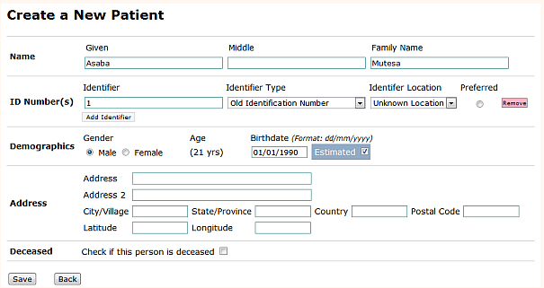
Registering Patients (Continued)
Click Save to go to the Patient Dashboard screen, where you can see all the details, enter forms, etc. for the newly created patient.

Slide 13
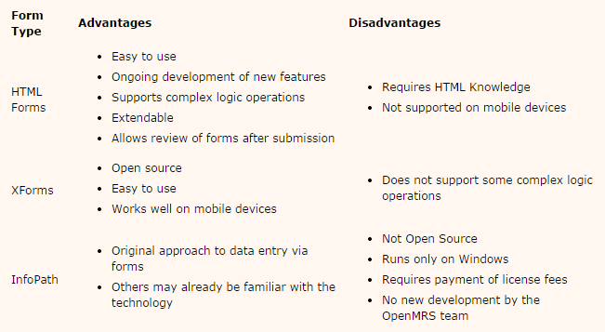
Data Entry
Data is collected using electronic forms, and a standard template means that each user sees the same structure, simplifying the representation of the underlying information structure and complexity. Electronic forms also allow for basic data validation.
There are three technologies for entering form data in OpenMRS. They are compared below.
We will discuss only the HTML Form entry method here

Slide 14
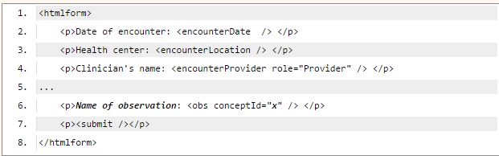
Basic HTML form structure
Every HTML Form must have the following minimal elements:

Slide 15
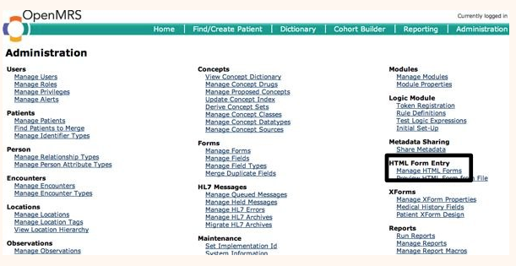
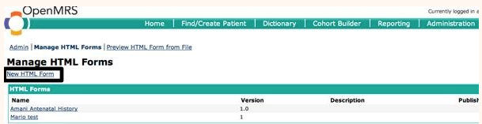
Create the form
To create a form, click on the Manage HTML Forms link on the Administration page.
Click New Form.

Slide 16
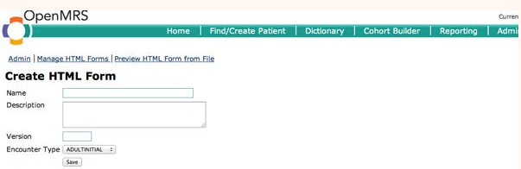
Create the form (Continued)
Enter the basic form information and click Save.

Slide 17
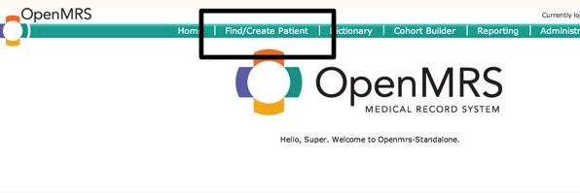
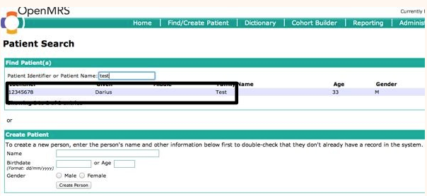
Enter patient data using an HTML form
Click on Find/Create Patient from anywhere within OpenMRS
Begin typing the patient's ID number or name, then select the patient for whom you are entering data.

Slide 18
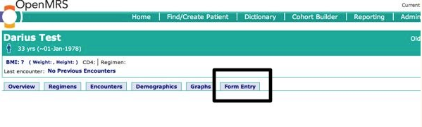
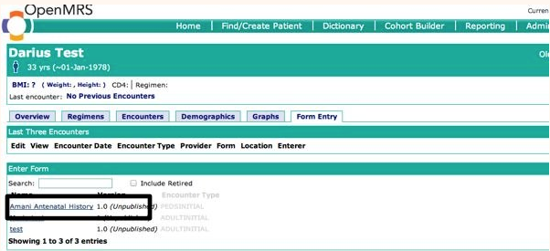
Enter patient data using an HTML form (Continued)
Click the Form Entry tab.
Select the appropriate form, then fill in the patient data and click the Enter Form button on the page that appears.

Slide 19
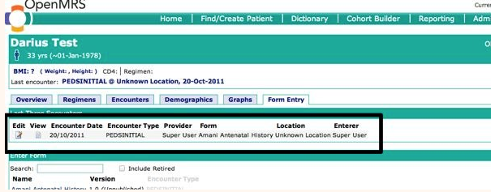
Enter patient data using an HTML form (Continued)
You can now see the completed form under the Form Entry tab of the patient's chart.

